Slide 1

Transcribify
Unlocking Voices, Transforming Video : Your Gateway to Seamless Amazon Transcribe Integration

Slide 2

Transcribify Project Journey
Gokul Prathin Asamani
Abhishek Jallawaram
Bhargavi Janga
Sanjana Achan

Slide 3

Inspiration
Make video transcription accessible and efficient.
Inspired by growing demand across various domains.
Goal: Seamlessly use Amazon Transcribe to unlock AWS power.

Slide 4
What We Learned
AWS Integration
AWS Transcribe and Comprehend for text and NLP.
Scalability
AWS Lambda, S3, and RDS for efficiency.
User Experience
React.js, Ant Design, and Next.js for an intuitive UI.
Real-time Updates
Next.js for engagement via real-time progress updates.
Cost Optimization
AWS Cost Explorer for budget management.
Collaboration
Effective teamwork in a hackathon setting.

Slide 5
Building the Project
Frontend
React.js, Ant Design, and Next.js.
Zustand and styled-components for state management.
Backend
Django for API endpoints.
AWS Services
Transcribe, Comprehend, Lambda, S3, and RDS.
Real-time Updates
WebSocket communication integrated into Next.js.
Cost Management
AWS Cost Explorer insights for cost optimization.

Slide 6
Challenges Faced
AWS Learning Curve
Enhanced cloud computing skills.
Scalability
Design and testing for large files and users.
Cost Control
Balancing user experience and cost.
Time Constraints
Efficient project management in a hackathon.

Slide 7
Demonstration
Github Repository: https://github.com/gokulprathin8/patriothacks-hackathon-dev-repo
Demo: https://youtu.be/UynTbwdTbJ4

Slide 8
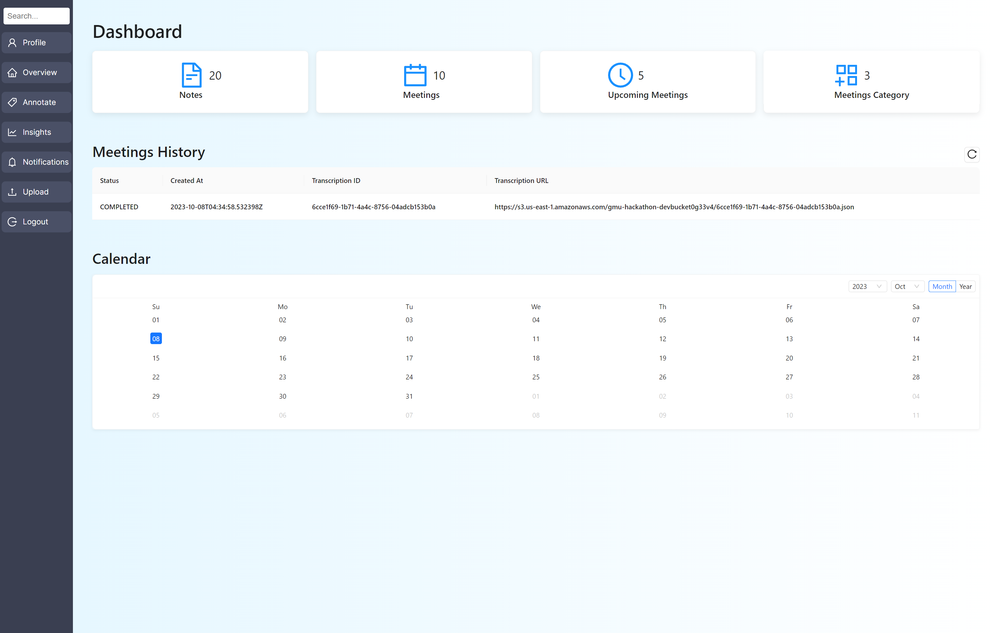
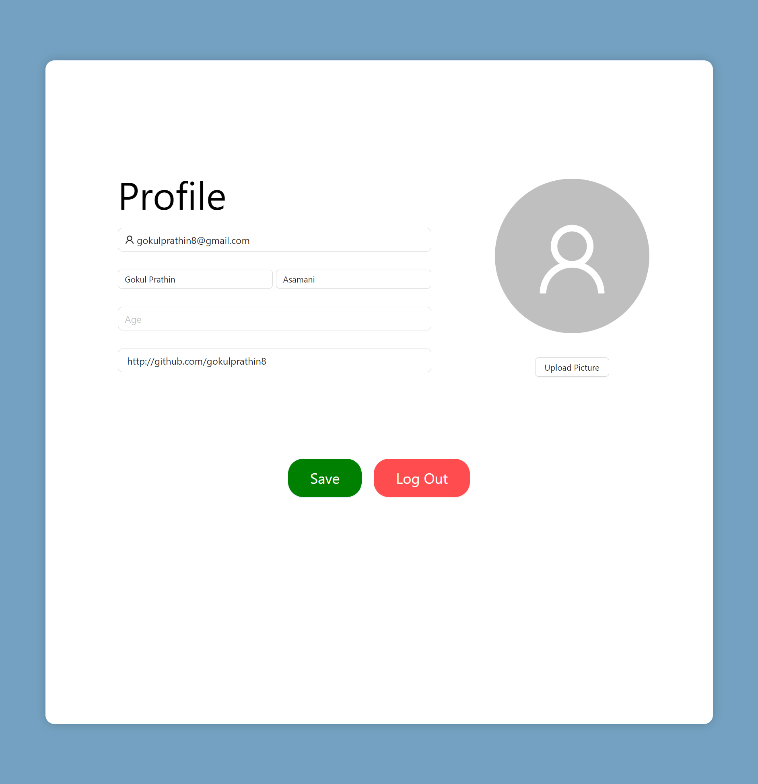
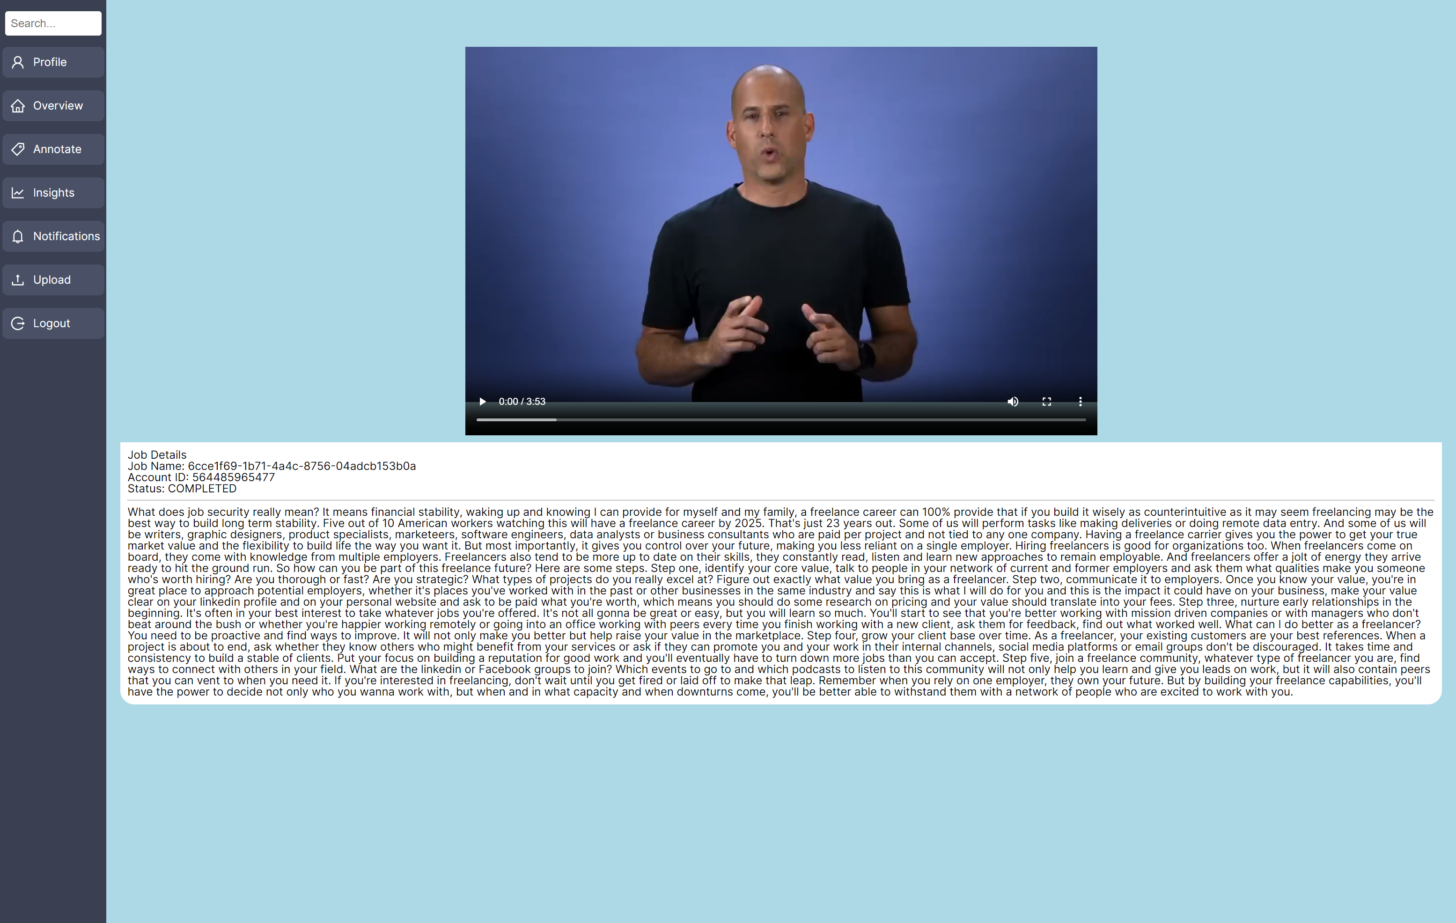


Slide 9
Looking Forward
Transcribify: Bridging the gap between video content and accessibility.
Born out of innovation and teamwork.
Transforming the way, we interact with video content.
Making the digital world more inclusive and valuable for everyone.

Slide 10
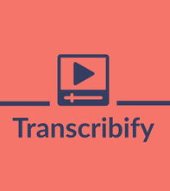
Thank you

